Slide 1

From Indexing Data Structure to De Bruijn Graphs
Bastien Cazaux ¹, Thierry Lecroq ², Eric Rivals ¹
¹ L.I.R.M.M. & Institut Biologie Computationnelle, Université de Montpellier II,
CNRS U.M.R. 5506, Montpellier, France
² LITIS EA 4108, NormaStic CNRS FR 3638, Université de Rouen, France
presentation by Giuseppe Miraglia
University of Pisa
19th, May 2014

Slide 2
A short introduction: DNA assembly
Align and merge DNA fragments (reads) in order to reconstruct the original DNA sequence
mainly de-novo vs. mapping techniques:
”reads assembled without reference bases, in
order to create full (also novel) sequence”
vs.
“reads assembled based on a reference genome
(backbone) to create similar sequence”
De-novo assembly uses de Bruijn Graphs of k-mers of reads (vs. overlaps graph, too memory)
Notes:
- Reads in genere composti tra le 20 e le 30.000 basi, dipendentemente dalla tecnologica utilizzata

Slide 3
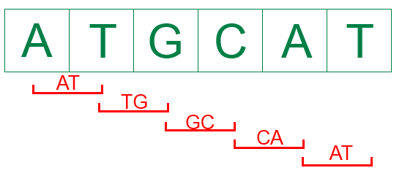
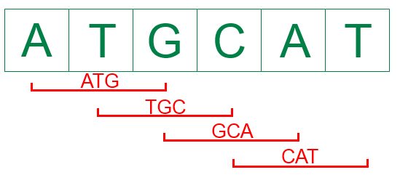

K-mers: an example
Let $s=ATCGAT$ a sequence of Nucleobases found within Nucleotides of a DNA sequence.
For $k=2$ we have the follow 2-mers:
For $k=3$ we have the follow 3-mers:
And so on…
Notes:
Adenina, Guanina, Citosina, Timina sono le basi azotate che compongono/si trovano dentro i nucleotidi del DNA

Slide 4
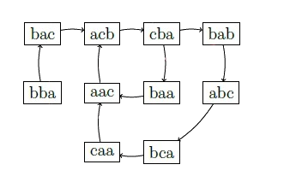
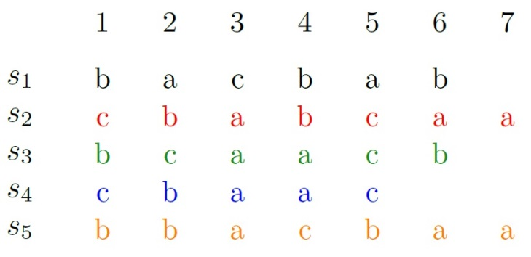
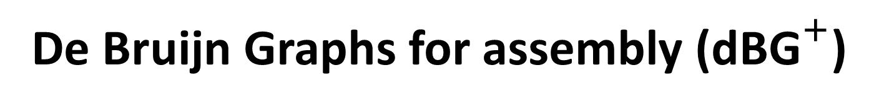
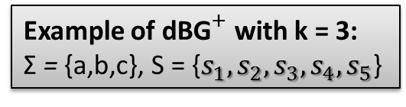
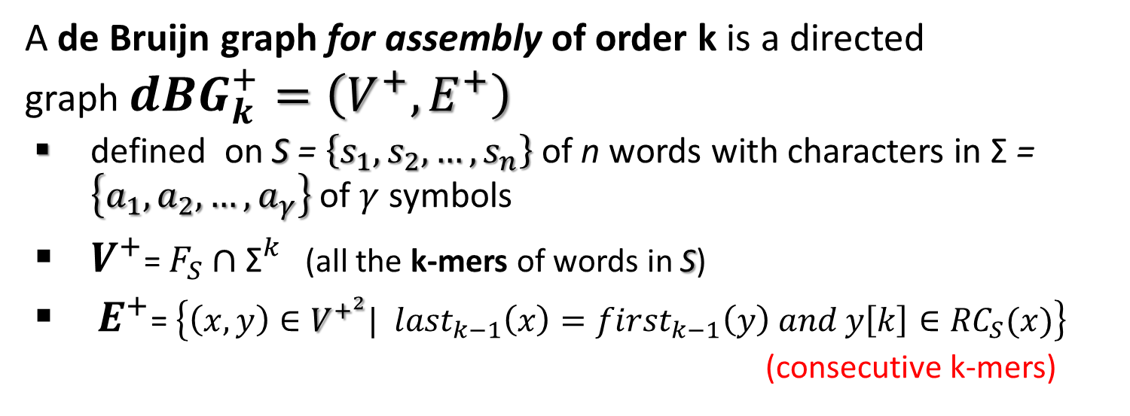
De Bruijn Graphs for assembly (${\text{dBG}}^{+}$)
A de Bruijn graph for assembly of order k is a directed
graph ${dBG}_{k}^{+}=\left(V^{+},E^{+}\right)$
defined on S = $\left\{s_{1}, s_{2}, …, s_{n}\right\}$of n words with characters in Σ = $\left\{a_{1}, a_{2}, …, a_{γ}\right\}$of $γ$symbols
$V^{+}$= $F_{S}∩{\text{Σ}}^{k}$ (all the k-mers of words in S)
${ E}^{+}$=$\left\{\left(x,y\right)∈V^{+^{2}}| {last}_{k−1}\left(x\right)={first}_{k−1}\left(y\right) and y\left[k\right]∈{RC}_{S}(x)\right\}$
(consecutive k-mers)
Example of ${\text{dBG}}^{+}$ with k = 3:
Σ = {a,b,c}, S = {$s_{1}, s_{2},s_{3}, s_{4}, s_{5}$}

Slide 5

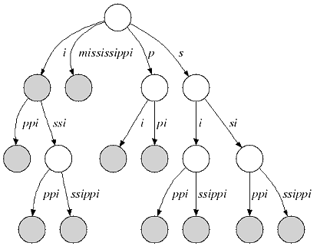
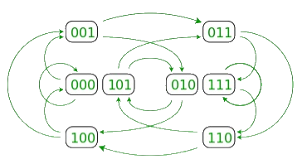
From Indexing Data Structures to dBG : Why?
Reads analysis/assembly includes preliminary steps (like error correction and filtering)
Such steps are performed using a data structure that represent an index on the reads
Assembly step uses dBG, created again on the reads
Is efficient to build the dBG directly from the already existing indexing data structure

Slide 6
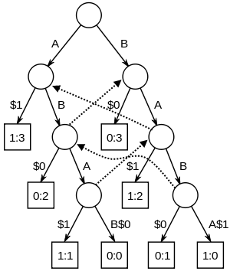

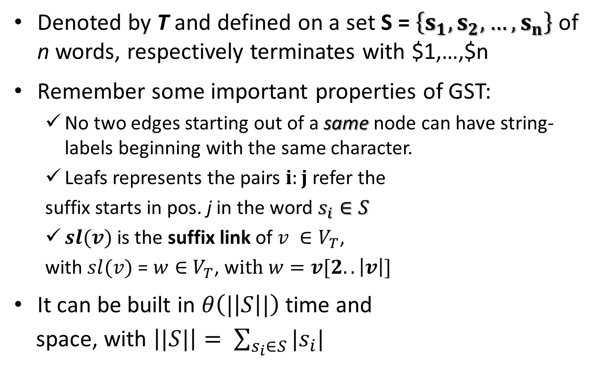
A common used index data structure: the Generalized Suffix Tree (GST)
Denoted by T and defined on a set S = $\left\{s_{1}, s_{2}, …, s_{n}\right\}$of n words, respectively terminates with $1,…,$n
Remember some important properties of GST:
No two edges starting out of a same node can have string-labels beginning with the same character.
Leafs represents the pairs $i:j$ refer the
suffix starts in pos. j in the word $s_{i}∈S$
$sl(v)$ is the suffix link of $v ∈V_{T}$,
with $sl(v)$ = $w∈$ $V_{T}$, w$ith w=v[2..\left|v\right|]$
It can be built in $θ\left(|\left|S\right||\right)$time and
space, with $\left||S|\right|= \sum_{s_{i}∈S}{|s_{i}|}$
A
BA
sl(ba)
GST for $s_{1}$= ABAB and $s_{2}$= BABA

Slide 7
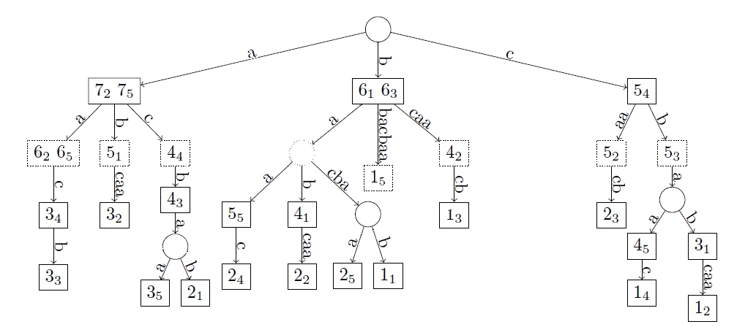
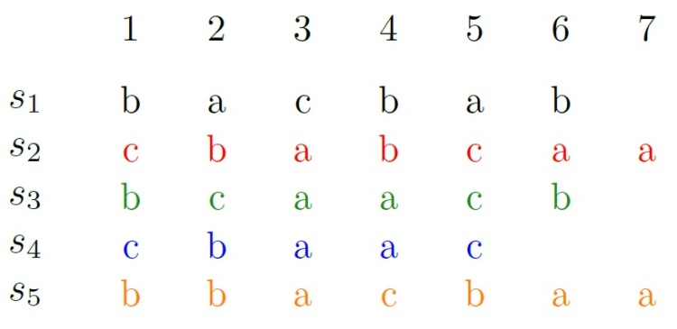

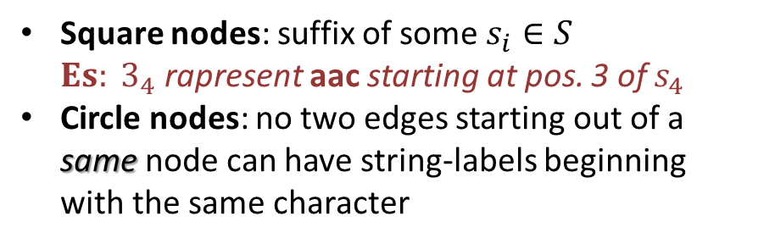
From GST to ${\text{dBG}2}^{+}$: elements
Square nodes: suffix of some $s_{i}∈S$
${Es: 3}_{4}$rapresent aac starting at pos. 3 of $s_{4}$
Circle nodes: no two edges starting out of a same node can have string-labels beginning with the same character

Slide 8

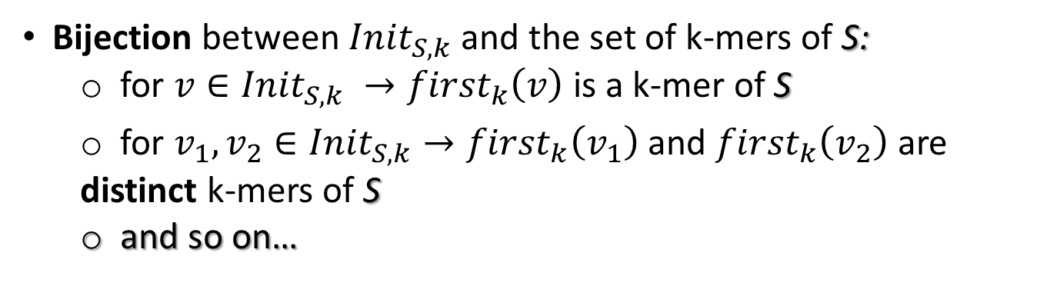

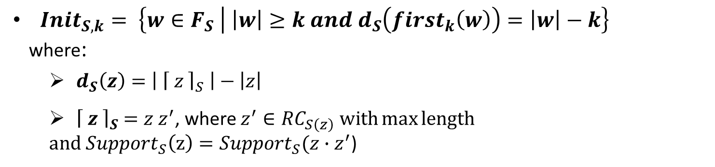
Mathematical “link” between GST and ${\text{dBG}}^{+}$
${Init}_{S,k}= \left\{w∈F_{S} | \left|w\right|≥k and d_{S}\left({first}_{k}\left(w\right)\right)=\left|w\right|−k\right\}$
where:
${ d}_{S}\left(z\right)=\left|{ \left\lceil z \right\rceil }_{S} \right|−\left|z\right|$
${ \left\lceil z \right\rceil }_{S} =z{ z}^{′}$, where $z^{′}∈{RC}_{S\left(z\right)} with\max{length}$
$and {Support}_{S}\left(z\right)={Support}_{S}(z∙z^{′}$)
${Init}_{S,k}=$ $\left\{{ \left\lceil {kmer}_{1}\right\rceil }_{S,…, }{ \left\lceil {kmer}_{m}\right\rceil }_{S }\right\}$
Bijection between ${Init}_{S,k}$ and the set of k-mers of S:
for $v∈{Init}_{S,k} →{first}_{k}\left(v\right)$is a k-mer of S
for $v_{1},v_{2}∈{Init}_{S,k}→{first}_{k}\left(v_{1}\right)$ and ${first}_{k}\left(v_{2}\right)$ are distinct k-mers of S
and so on…
Notes:
${Init}_{S,k}$ stringhe di $F_{S}$ che iniziano con un k-mer ($first﷮k$) e proseguono con la sua massima estensione che non cambia il supporto
${\left\lceil z \right\rceil }_{S}$ = zz’ massima estensione destra di z avente lo stesso supporto
$d_{S}\left(z\right)$ lunghezza di z’
Biezione: legge che associa a ogni elemento di A uno e un solo elemento di B, viceversa a ogni elmento di B corrisponde uno e un solo elemento di A

Slide 9
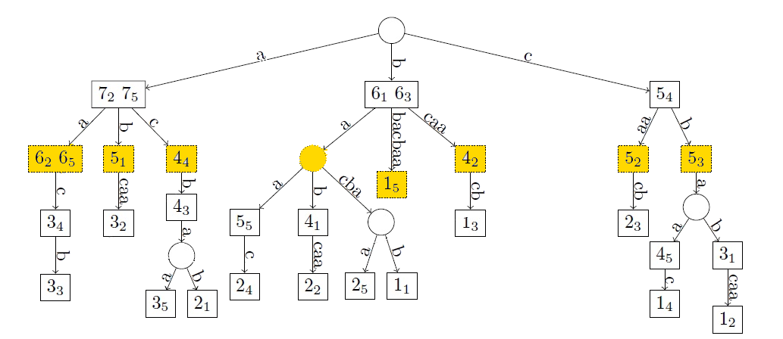
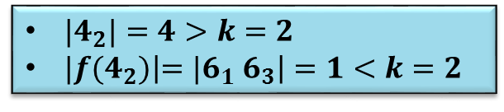


From GST to ${\text{dBG}2}^{+}$: nodes (${\text{V}}^{+}$)
${|4}_{2}|=4>k=2$
${|f(4}_{2})\left|={|6}_{1}{ 6}_{3}\right|=1<k=2$
Who are the elements of ${Init}_{S,k}$ obtained starting from GST?
${Init}_{S,k}=$ $\left\{ v∈V_{T} | \left|father\left(v\right)\right|<k and \left|v\right|≥k \right\}$

Slide 10

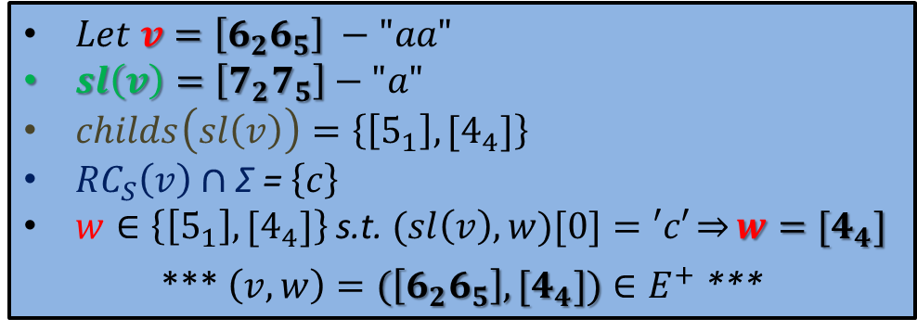
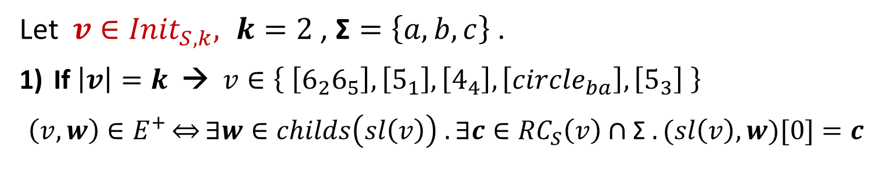
From GST to ${\text{dBG}2}^{+}$: edges (${\text{E}}^{+}$)
Let $v∈{Init}_{S,k}, k=2$ , $\text{Σ}=\left\{a,b,c\right\}$.
If $\left|v\right|=k$ → $v∈\left\{ \left[6_{2}6_{5}\right], \left[5_{1}\right], \left[4_{4}\right], \left[circle_{ba}\right], \left[5_{3}\right] \right\}$
$$\left(v, w\right)∈E^{+}\overset{⇔}{}∃w∈childs\left(sl\left(v\right)\right) .∃c∈{RC}_{S}\left(v\right)∩\text{Σ} . (sl\left(v\right),w)[0]=c$$
$Let v=\left[6_{2}6_{5}\right] −"aa"$
$sl\left(v\right)=\left[7_{2}7_{5}\right]−"a"$
$childs\left(sl\left(v\right)\right)=\left\{\left[5_{1}\right],[4_{4}]\right\}$
${RC}_{S}\left(v\right)∩\text{Σ} \text{=} \left\{c\right\}$
$w∈\left\{\left[5_{1}\right],[4_{4}]\right\}$ s.t. $(sl\left(v\right),w)[0]=′c′\overset{⇒}{}w={[4}_{4}]$
*** $\left(v,w\right)=(\left[6_{2}6_{5}\right],{[4}_{4}])∈E^{+}$ ***

Slide 11


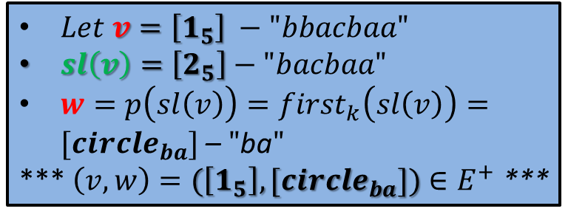
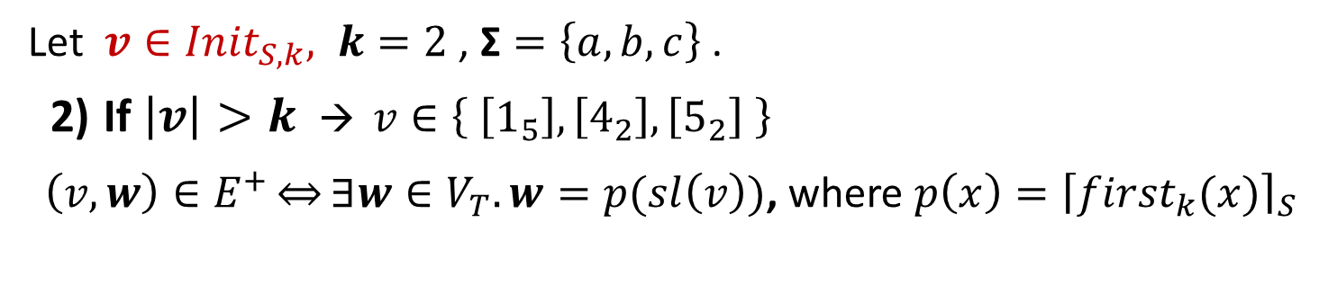
From GST to ${\text{dBG}2}^{+}$: edges (${\text{E}}^{+}$) – cont.
Let $v∈{Init}_{S,k}, k=2$ , $\text{Σ}=\left\{a,b,c\right\}$.
If $\left|v\right|>k$ → $v∈\left\{ \left[1_{5}\right], \left[4_{2}\right], \left[5_{2}\right] \right\}$
$\left(v, w\right)∈E^{+}\overset{⇔}{}∃w∈V_{T}. w=p(sl\left(v\right))$, where $p\left(x\right)={\left\lceil {first}_{k}(x)\right\rceil }_{S}$
$Let v=\left[1_{5}\right] −"bbacbaa"$
$sl\left(v\right)=\left[2_{5}\right]−"bacbaa"$
$w=p\left(sl\left(v\right)\right)={first}_{k}\left(sl\left(v\right)\right)=[{circle}_{ba}]$ – $"$ba$"$
*** $\left(v,w\right)=(\left[1_{5}\right],[{circle}_{ba}])∈E^{+}$ ***
$$p\left(\left[2_{5}\right]\right)={first}_{k}\left({[2}_{5}]\right)=[{circle}_{ba}]$$

Slide 12
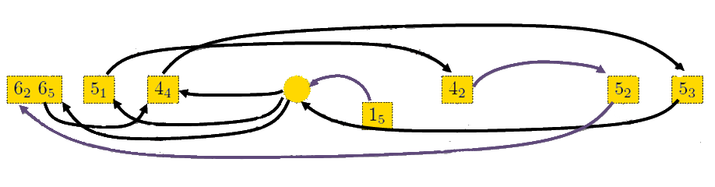
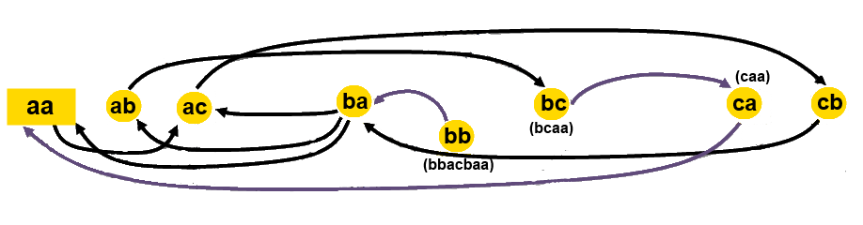
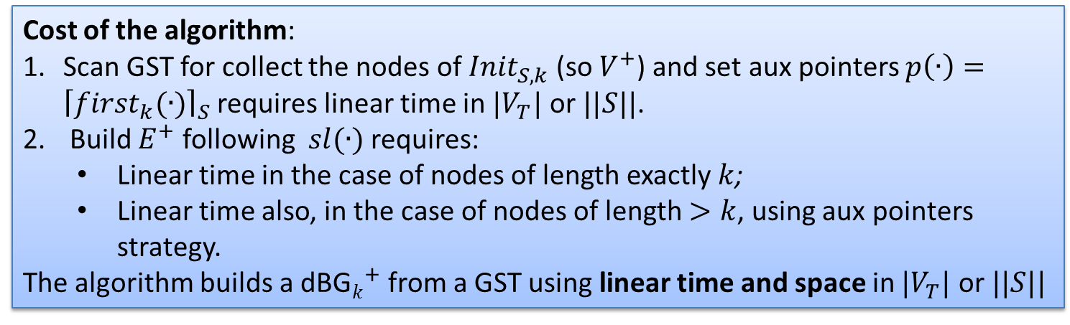

From GST to ${\text{dBG}2}^{+}$: results
Cost of the algorithm:
Scan GST for collect the nodes of ${Init}_{S,k}$(so $V^{+}$) and set aux pointers $p\left(∙\right)={\left\lceil {first}_{k}(∙)\right\rceil }_{S}$ requires linear time in $|V_{T}|$ or $||S||$.
Build $E^{+}$ following $sl(∙)$ requires:
Linear time in the case of nodes of length exactly $k$;
Linear time also, in the case of nodes of length $>k$, using aux pointers strategy.
The algorithm builds a ${\text{dBG}k}^{+}$ from a GST using linear time and space in $|V_{T}|$ or $||S||$

Slide 13
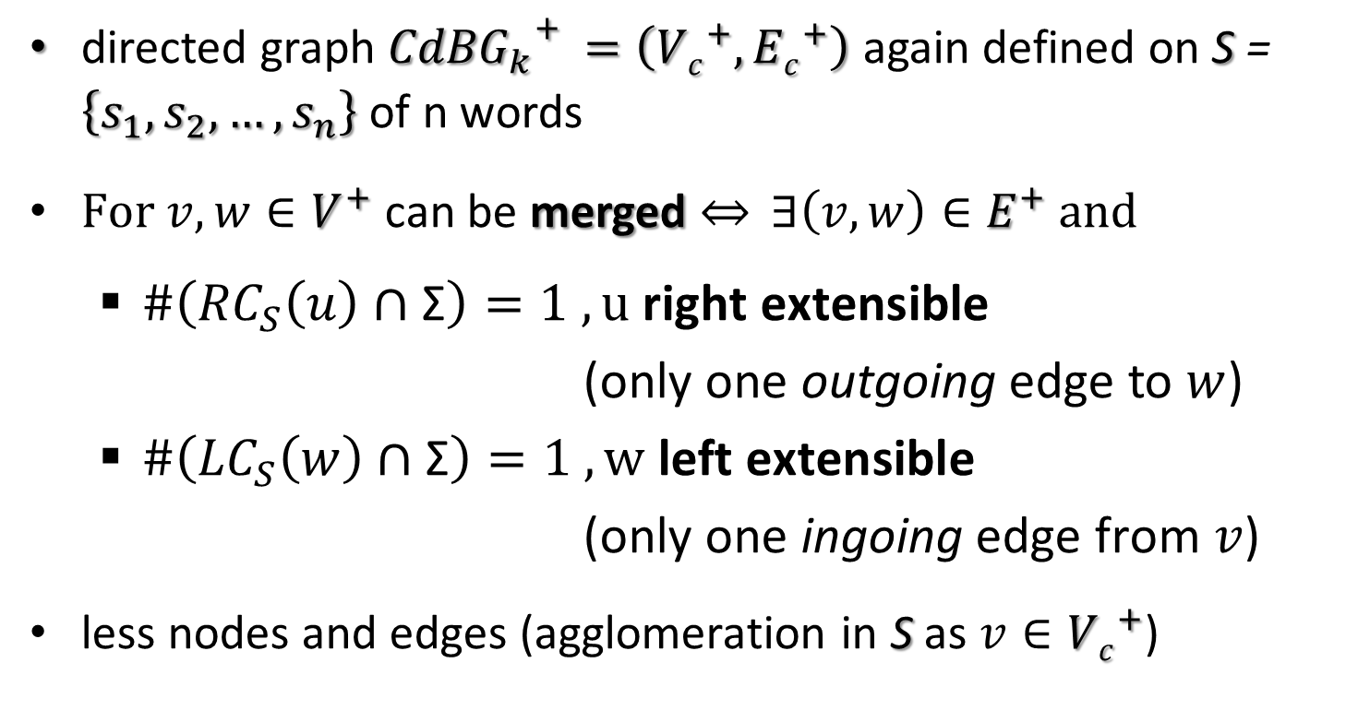

Contracted de Bruijn Graph for assembly (${\text{C}\text{dBG}k}^{+})$ : build it from ${\text{dBG}k}^{+}$
directed graph ${{CdBG}_{k}}_{}^{+}=\left({Vc}^{+},{Ec}^{+}\right)$ again defined on S = $\left\{s_{1}, s_{2}, …, s_{n}\right\}$ of n words
$For v,w∈V^{+}$ can be merged $\overset{⇔}{} ∃\left(v,w\right)∈E^{+} and$
$\#\left({RC}_{S}\left(u\right)∩\text{Σ}\right)=1 ,u \text{right} \text{extensible}$
$\text{(}\text{only} \text{one} \text{out}\text{going} \text{edge}$ to $w$)
$\#\left({LC}_{S}\left(w\right)∩\text{Σ}\right)=1 , \text{w} \text{left} \text{extensible}$
$\text{(}\text{only} \text{one} \text{ingoing} \text{edge} \text{from} v$)
less nodes and edges (agglomeration in S as $v∈{Vc}^{+}$)

Slide 14

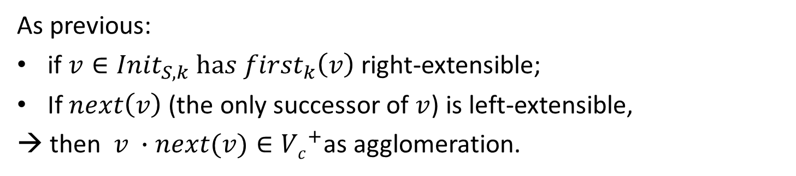




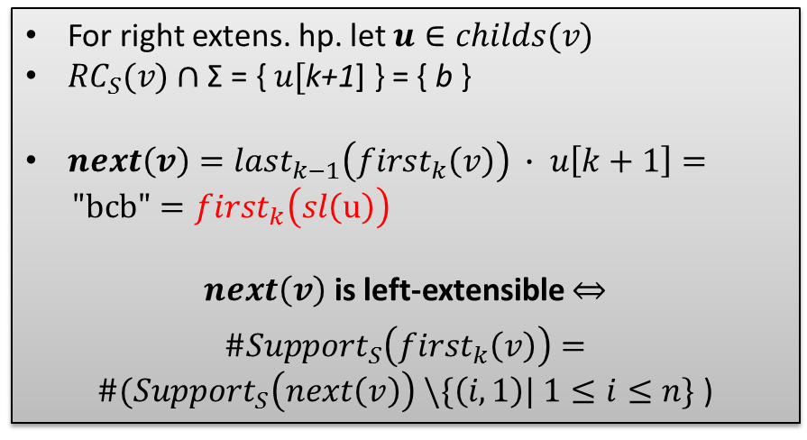

Build ${\text{C}\text{dBG}k}^{+}$directly from GST
As previous:
if $v∈{Init}_{S,k} has {first}_{k}\left(v\right)$right-extensible;
If $next\left(v\right)$ (the only successor of $v$) is left-extensible,
→ then $v ∙next(v)∈{Vc}^{+}$as agglomeration.
$\left|v\right|=k (so v={first}_{k}\left(v\right))$
For right extens. hp. let $u∈childs(v)$
${RC}_{S}(v)∩\text{Σ}\text{ = \{ }u[\text{k}\text{+1}\text{]} \text{\}} \text{= \{ }\text{b} \text{\}}$
${next\left(v\right)=last}_{k−1}\left({first}_{k}\left(v\right)\right) ∙ u\left[k+1\right]=$
$\text{"}\text{bcb}\text{"}={first}_{k}\left(sl\left(\text{u}\right)\right)$
$next\left(v\right)$ is left-extensible
${\#Support}_{S}\left({first}_{k}\left(v\right)\right)={\#(Support}_{S}\left(next\left(v\right)\right) \backslash \{\left(i,1\right)| 1≤i≤n\}$)
$$v=abc$$
$$sl\left(u\right)=bcbc$$
$$bc$$
$$u=abcbc$$

Slide 15
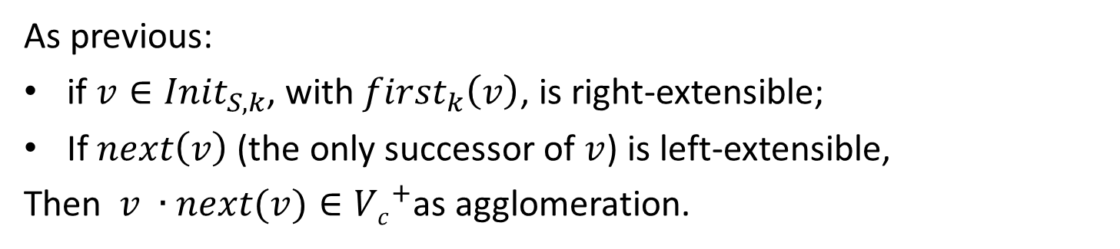


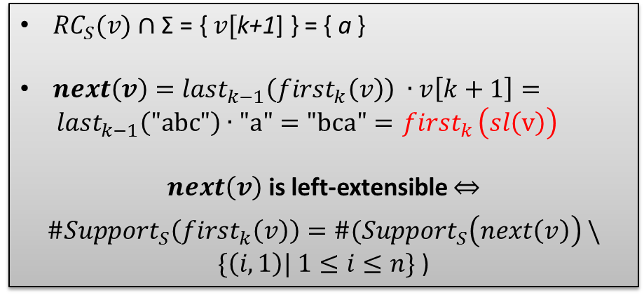

Build ${\text{C}\text{dBG}k}^{+}$directly from GST- cont
As previous:
if $v∈{Init}_{S,k}$, with ${first}_{k}\left(v\right)$, is right-extensible;
If $next\left(v\right)$ (the only successor of $v$) is left-extensible,
Then $v ∙next(v)∈{Vc}^{+}$as agglomeration.
$\left|v\right|>k$
${RC}_{S}(v)∩\text{Σ}\text{ = \{ }v[\text{k}\text{+1}\text{]} \text{\}} \text{= \{ }\text{a} \text{\}}$
${next\left(v\right)=last}_{k−1}\left({first}_{k}\left(v\right)\right) ∙v\left[k+1\right]=$
${last}_{k−1}\left("\text{abc}\text{"}\right)∙\text{"}\text{a}\text{"}=\text{"}\text{bca}\text{"}={ first}_{k}\left(sl\left(\text{v}\right)\right)$
$next\left(v\right)$ is left-extensible
${\#Support}_{S}\left({first}_{k}\left(v\right)\right)={\#(Support}_{S}\left(next\left(v\right)\right) \backslash \{\left(i,1\right)| 1≤i≤n\}$)
$$v=abca$$
$$sl\left(u\right)=bcbc$$

Slide 16
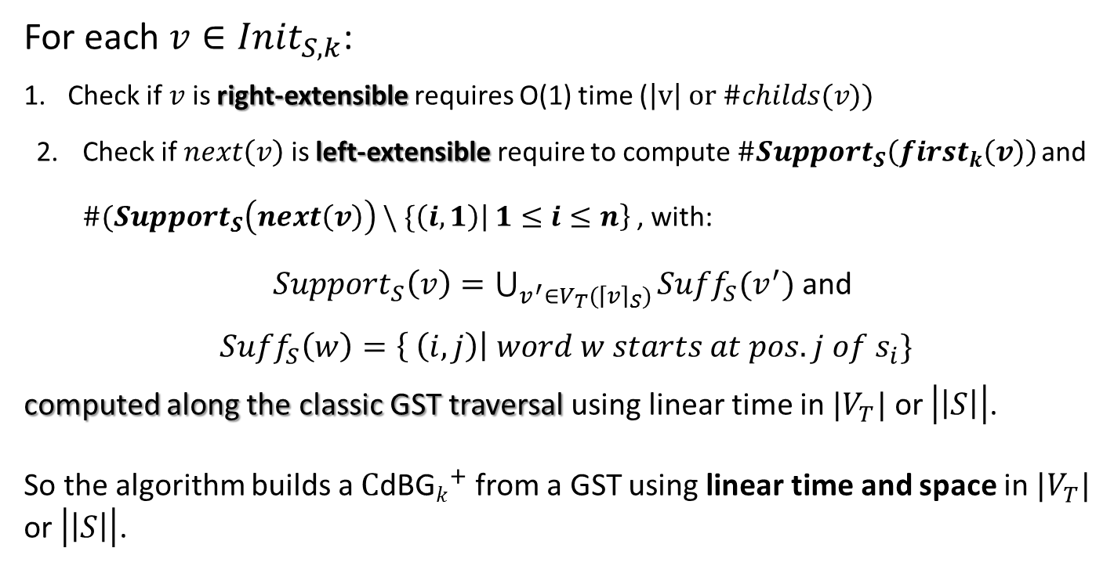

${\text{C}\text{dBG}k}^{+}$from GST: algorithm cost
For each $v∈{Init}_{S,k}$:
Check if $v$is right-extensible requires O(1) time ($\left|v\right| or \#childs(v))$
Check if $next\left(v\right)$is left-extensible require to compute${ \#Support}_{S}\left({first}_{k}\left(v\right)\right)$ and ${\#(Support}_{S}\left(next\left(v\right)\right) \backslash \{\left(i,1\right)\left| 1≤i≤n\right\}$, with:
${Support}_{S}\left(v\right)=\bigcup_{v^{′}∈V_{T}({\left\lceil v\right\rceil }_{S})}{{Suff}_{S}(v^{′})}$and
${Suff}_{S}\left(w\right)=\left\{ \left(i,j\right)\right| word w starts at pos. j of s_{i}\}$
computed along the classic GST traversal using linear time in $|V_{T}|$ or $\left|\left|S\right|\right|$.
So the algorithm builds a $C{\text{dBG}k}^{+}$ from a GST using linear time and space in $|V_{T}|$ or $\left|\left|S\right|\right|$.

Slide 17
Conclusions
Building dBG directly from GST is most relevant when manage massive datasets of reads O(TByte)
dBG can be also built from Suffix Array (SA) using aux LCP (Longest Common Prefix) Array
SA have the same properties of ST
In practice, SA is space less expensive than ST:
array of integers vs. tree structure with integers and pointers

Slide 18
Thanks to the authors, Thanks for your attention

